Slide 1

Convolutional Neural Network for Movie Genre classification
Presented by : Ron Sider and Jordan Tangy

Slide 2
Steps of our presentation :
Introduction
1.1 What we want to achieve in our project
Our dataset and some examples
Implementation
3.1 Dealing with the dataset (Normalization, splitting,..)
3.2 Convolutional Neural Network Architecture
3.3 Training
3.4 Results (Model Accuracy and Model Loss)
3.5 Some examples of testing
4. Conclusion

Slide 3
1- Introduction
1.1 What we want to achieve in our project

Slide 4
Given a large data set of Movie Poster, we want to create a model that will be able to classify the model to its genre.
For such a task we downloaded a data Set from Kaggle which contains :
A file of 41K different movie posters
A csv file which contains all the metadata and the classification of the movies
We used only 30K images (lack of RAM)
We used the Google Colab platform to carry out this work.

Slide 5
2 - Our dataset and some examples

Slide 6
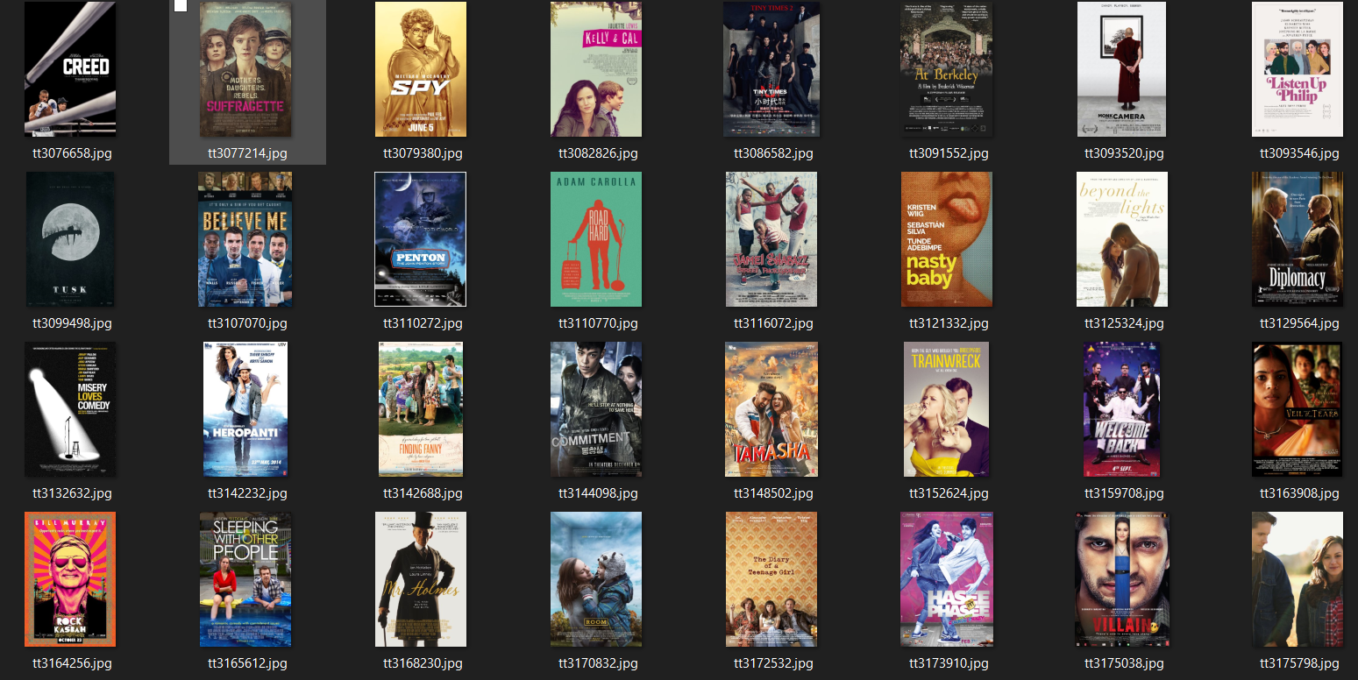
A sample from our images file

Slide 7
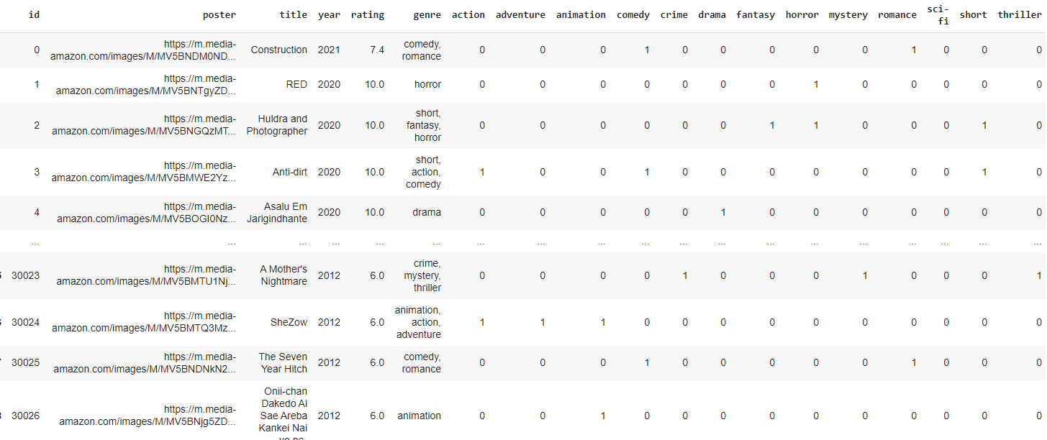
A sample from our csv file

Slide 8
Implementation
3.1 Dealing with the dataset (Normalization, splitting,..)

Slide 9
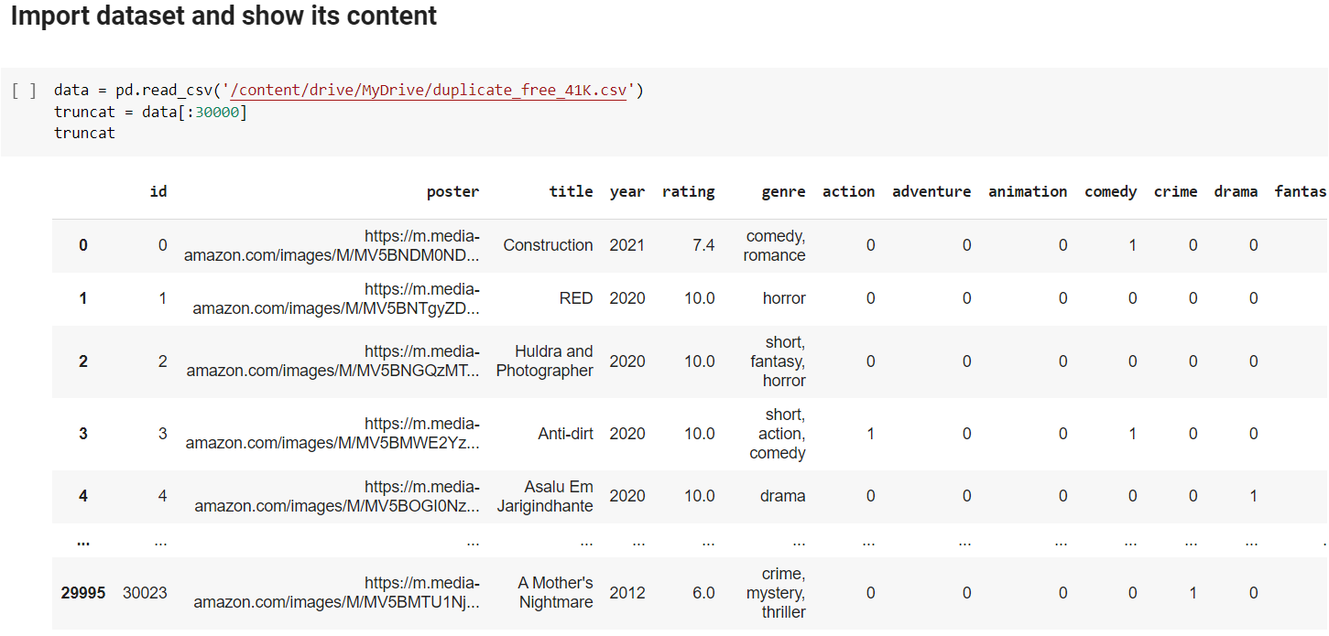
Converting csv file to pandas Dataframe

Slide 10
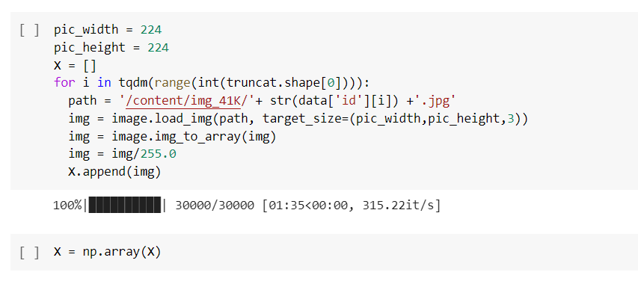
Insertion of the pictures into a manageable array

Slide 11
Insertion of the pictures into a manageable array

Slide 12
Rearranging y data by dropping irrelevant fields
Our aim is to “cut” the data frame and get the array representing the classification of the movies (1’s and 0’s only)

Slide 13
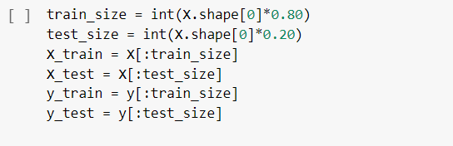
Splitting the dataset into train set and test set
Training data size = 80%
Testing data size = 20%

Slide 14
Implementation
3.2 Convolutional Neural Network Architecture

Slide 15
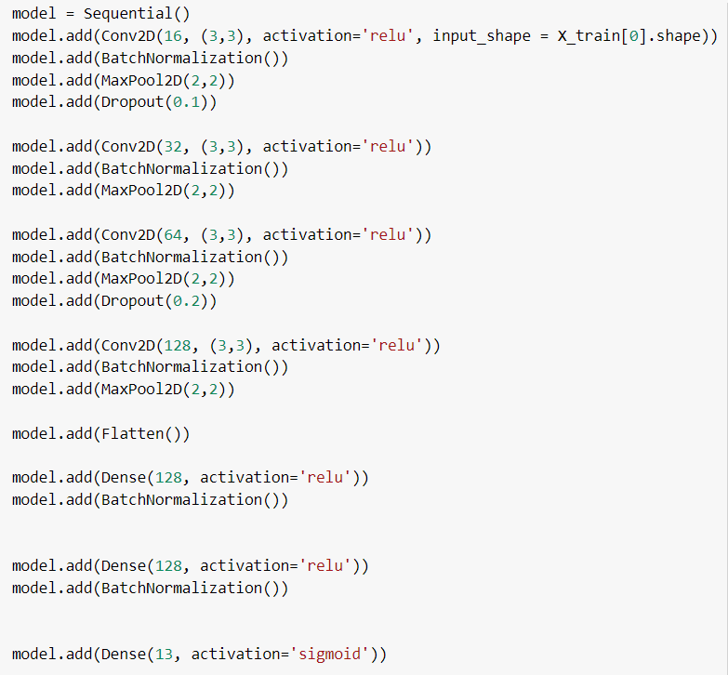
ConvNet Architecture
}
16 filters, each one of size 3x3 (Relu Activation Function)
Batch Normalization → Maxpooling 2x2 → 10% DropOut
}
32 filters, each one of size 3x3 (Relu Activation Function)
Batch Normalization → Maxpooling 2x2
}
64 filters, each one of size 3x3 (Relu Activation Function)
Batch Normalization → Maxpooling 2x2 → 20% DropOut
}
128 filters, each one of size 3x3 (Relu Activation Function)
Batch Normalization → Maxpooling 2x2
}
}
Flatten Layer
Dense Layer (128 neurons) , Relu Activation Function Batch Normalization
}
Dense Layer (128 neurons) , Relu Activation Function Batch Normalization
}
Output Layer (13 neurons), Sigmoid Activation Function (We assumed that there are no relationship between genres)

Slide 16
Implementation
3.3 Training

Slide 17
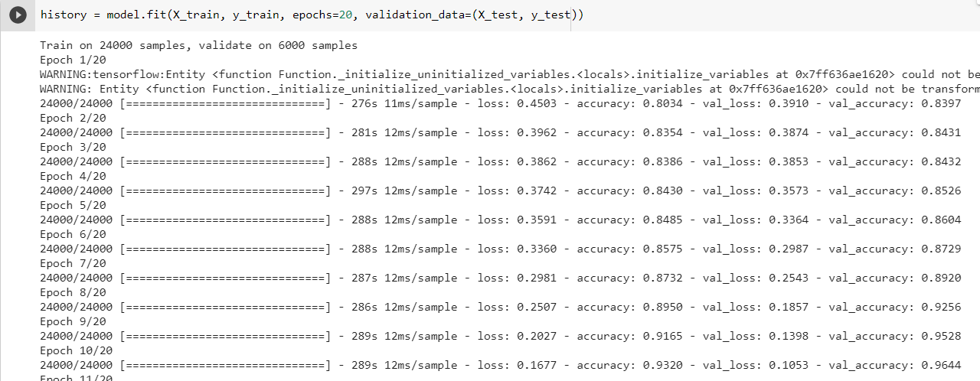
Compiling and training the model

Slide 18
Compiling and training the model
Optimizer :
Adam Optimizer : Empirically, Adam gave use better results than other optimizers
We assumed that there are a lot of noisy problems (even between pictures of the same genre) and because Adam handle noisy problems, it was another reason for us to choose this algorithm instead of SGD ,RMSProp or Adagrad
Loss function:
Binary Cross entropy loss function is independent for each vector component (class), meaning that the loss computed for the CNN output vector component is not affected by other component values. That’s why it is used for multi-label classification

Slide 19
Compiling and training the model
-Training of 24000 samples, validating on 6000 samples
-20 epochs

Slide 20
Implementation
3.4 Results (Model Accuracy and Model Loss)

Slide 21
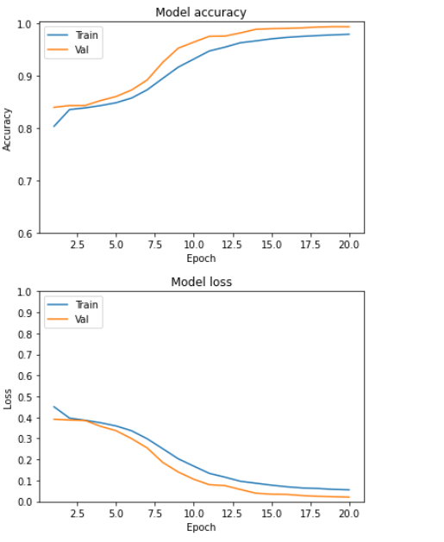
Plots of our results
It seems that validation accuracy is higher than training accuracy because when we use dropout , we use it only for the training and not for the validation.
For the loss, the validation loss is smaller than the training loss for the same reason mentioned previously

Slide 22
Implementation
3.5 Some examples of testing

Slide 23
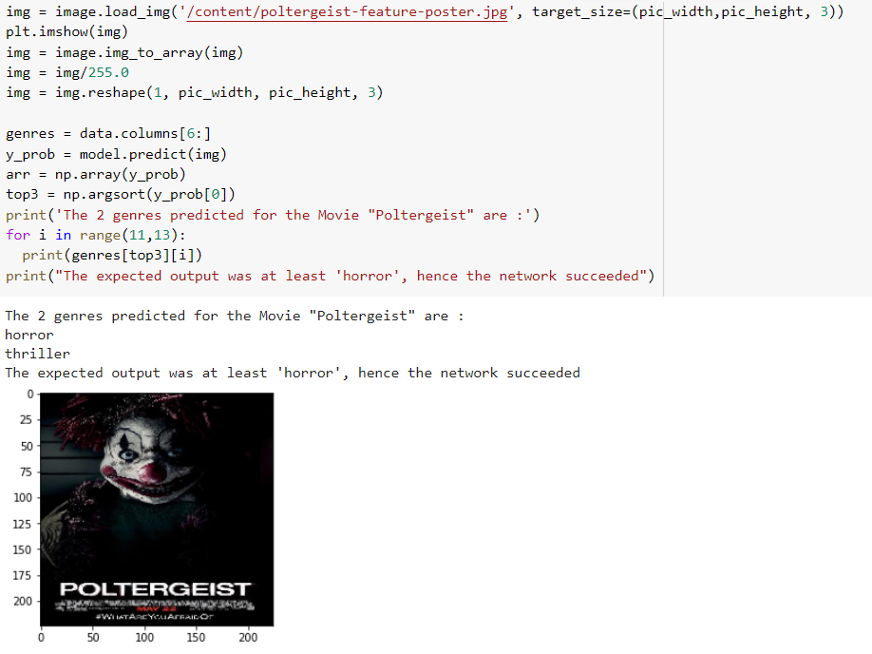
Testing Examples

Slide 24

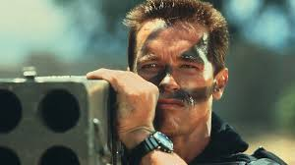

Genre Classification
CNN
CNN
Comedy,
Action
Action
CNN
Horror

Slide 25
General Steps
1. importing the data to environment(pandas)
2. Discarding irrelevant data.
3. Splitting the data to train and test sets.
4. deploying model of Convolutional Network.
5.Training the model.
6.deploying the results to test set.

Slide 26
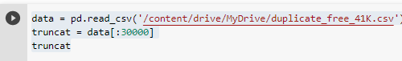
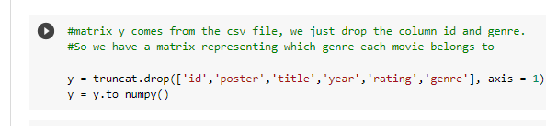
Data slicing(steps : 1,2,3)
30000 samples
Dropping irrelevant features

Slide 27
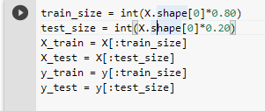
Train & Test set
Train set size = 30000*0.8 = 24000 training samples
Test set size = 30000*0.2 = 6000 test samples

Slide 28
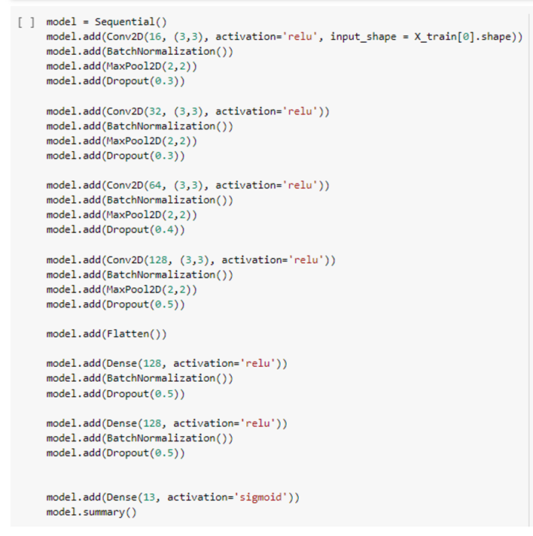
Convolutional Neural Network - model

Slide 29
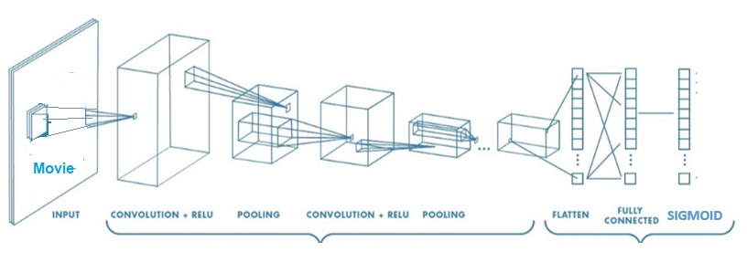



Model Visual Description
Action
Comedy
Horror
Sci Fi
.
.
.
4 Convolutional Layers. Sigmoid serves as an activation layer.

Slide 30
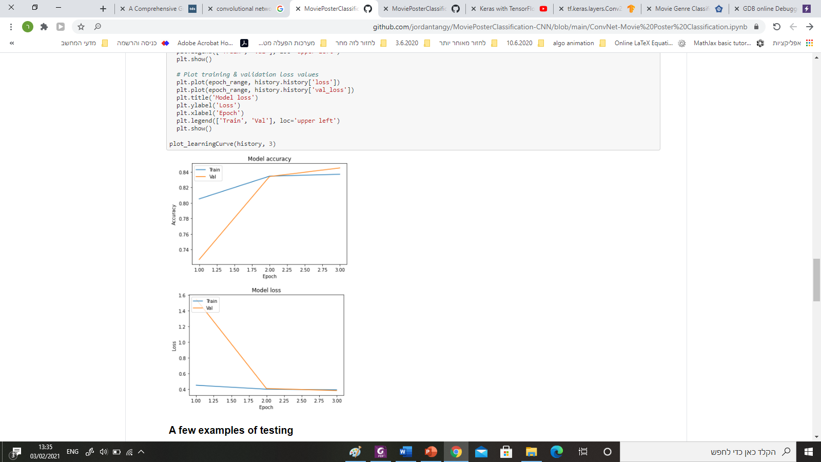
Results

